Slide 1
Overview
Technical Object
Data Elements
Domain
Structures
Table Types
Tables
Aggregate Objects
Views
Search Helps
Lock Objects
Table Maintenance Generator
Database Utility
Data Dictionary

Slide 2
Overview

Slide 3
Technical Object
Domain
Data Elements
Structures
Table Types

Slide 4
Domain
It describes the
Technical properties s like data type and length, Decimal Places
Semantic Properties like Output Length, Possible values
4

Slide 5
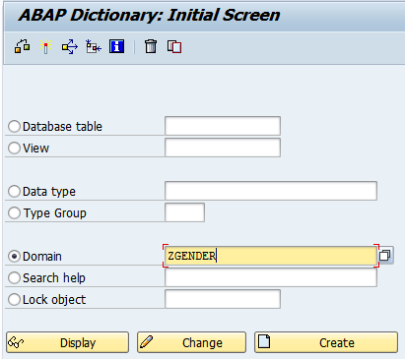
Domain: Create Domain
Steps:
Transaction Code: SE11
Select Domain Radio Button
Enter Name of the Domain
Click on Create Button
1. Select “Domain” Radio Button
2. Enter Domain Name
3. Click on Create Button
5

Slide 6
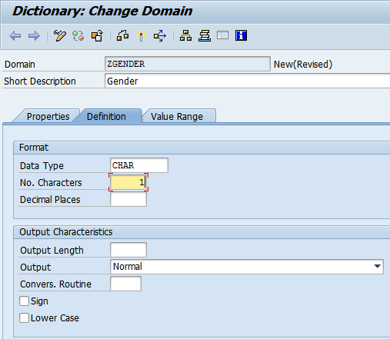
Domain: Create Domain Contd..
4. Enter Description
Steps:
Enter Description
Click on Definition Tab
Enter Data Type and No Characters
5. Select Definition Tab
6. Enter Data Type and Length
6

Slide 7
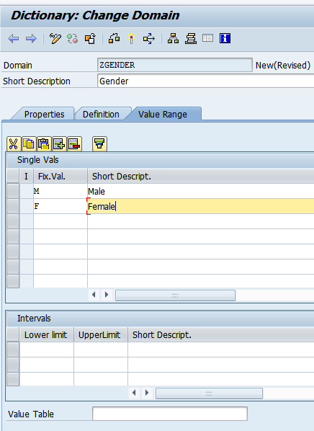
Domain: Create Domain Contd..
Steps:
Select Value Range Tab
Enter Single Values
Click on Save Button
7. Select Value Range Tab
8. Enter set of Fixed Values/Ranges/Value Table
7

Slide 8
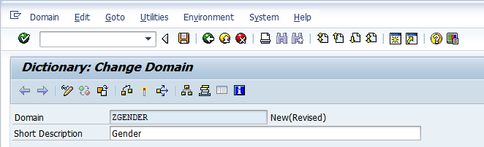
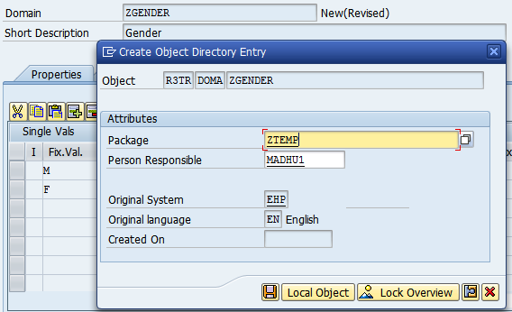
Domain: Create Domain Contd..
9. Click on Save Button
Steps:
Click on Save Button
Enter Package and Click on Save Icon
10. Enter Package
8

Slide 9
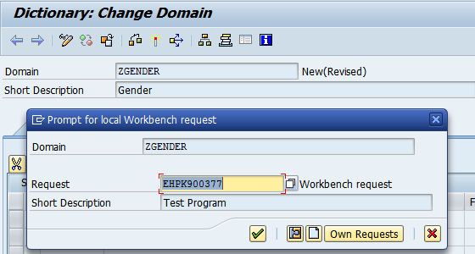
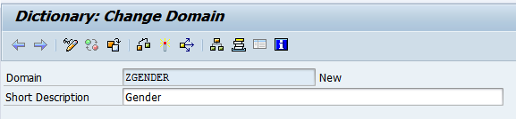
Domain: Create Domain Contd..
11. Enter Transport Number
Steps:
Enter Transport
Syntax Check
Activate
12. Check for syntax errors
13. Activate
9

Slide 10
Data Element
Data Elements for defining Technical Properties and Semantic Properties
Technical Properties includes Domain or Predefined Types
Semantic Properties includes
Field Label: it will help us to enter Label for the field in various lengths
Further Characteristics: Help us to assign search help and Parameter IDs
We can Data Elements in Structure Creation, Table Creation, User Defined Types declaration and Variable Declaration
10

Slide 11
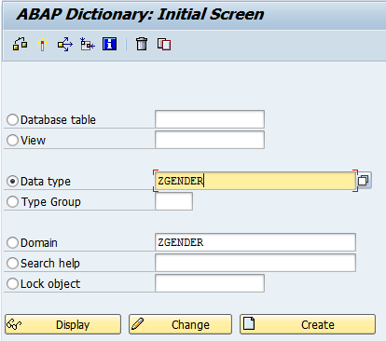
Create Data Element
1. Select Data Type Radio Button
2. Enter Data Element Name
3. Click on Create Button
11

Slide 12
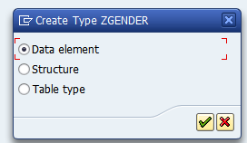
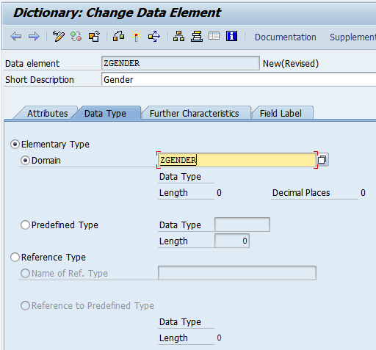
Create Data Element
4. Select Data Element Radio Button
5. Enter Description
6. Select Data type Tab
9. Enter Domain Name
7. Select Elementary Type Radio Button
8. Select Domain Radio Button
12

Slide 13
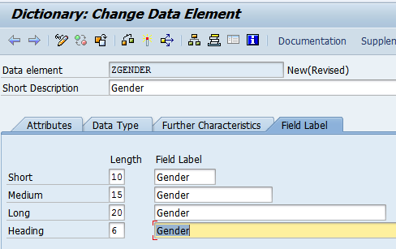
Create Data Element
10. Select Field Label Tab
11. Enter Descriptions
12. Save
13. Syntax Check
14. Activate
10. Select Field Label Tab
11. Enter all Descriptions
Short, Medium, Long and Heading
13

Slide 14
Structure
Structure is Dictionary object to group the fields
Its reusable component and
Can be used to define Table Types
Can be used in Tables
Can be used in ABAP Programs to declare Work areas and Internal Tables
Can be used to specify type in the Interface parameters of Forms, Function Modules, Methods
14

Slide 15
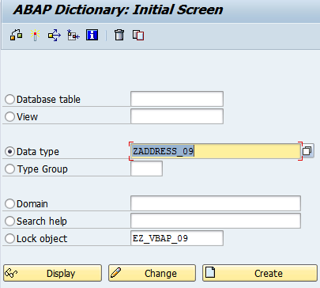
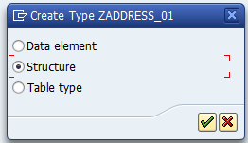
Create Structure
Select Datatype Radio Button
Enter Structure Name
Select Table Tab
Select Structure Radio Button
15

Slide 16
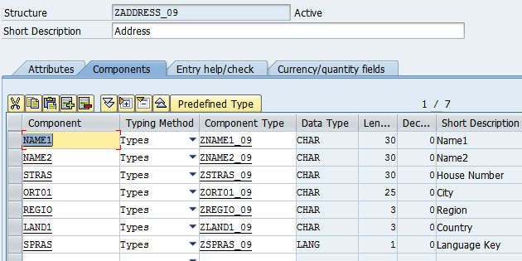
Create Structure
Enter fields and data types
16

Slide 17
Table Type
Structure is Dictionary object to group the fields
Its reusable component and
Can be used in ABAP Programs to declare Internal Tables
Can be used to specify type in the Interface parameters of Forms, Function Modules, Methods
17

Slide 18
Create Table Type
18

Slide 19
Tables
Overview
Types of Tables
Delivery and Maintenance
Field Settings
Technical Settings
Currency and Quantity Fields
Foreign Key

Slide 20
Overview
Structure or definition of database table is created and with this structure of physical database table is created in the underlying database system.
Table Properties:
Delivery and Maintenance
Fields and its Properties
Key
Currency and Quantity
Help
Technical Settings
Indexes
Append Structures
20

Slide 21
Overview
Delivery
A – Application Data: It can be Master Data or Transaction Data
C – Customizing Data: Configuration Data
Browser and Maintenance Type
To enable of disable maintenance of the entries in the table using SM30
Allowed: Display and Maintenance Allowed
Allowed with Restriction:
Not Allowed: Not allowed to display as well from SE16
21

Slide 22
Overview
Fields: Field are columns in the table.
Specify following
Field Name
Key Specification
Data Type & Length
Foreign Key relationship
Search Help assignment
22

Slide 23
Overview
Searching:
It is a method for finding a particular value in a list
Linear Search
It checks each element in sequence until the desired element is found or the list is exhausted.
The list need not be ordered.
Binary Search
It divides a range of values into halves, and continues to narrow down the field of search until the unknown value is found
The list should be in Sorted Order
23

Slide 24
Overview
Technical Setting:
Buffering
It speeds of the data access by temporarily stores the more frequently accessed data in the buffer. i.e. In the memory of application server.
Buffering Types
Single Buffering: It will buffer only one record
Generic Buffering: It will buffer multiple records based on key fields
Full Buffering: it will buffer all the accessed records
24

Slide 25
Overview
Quantity:
If table has field having data type ‘QUAN’ then specify reference table and reference field which is having data type ‘UNIT’
Currency:
If table has field having data type ‘CURR’ then specify reference table and reference field which is having data type ‘CUKY’
25

Slide 26
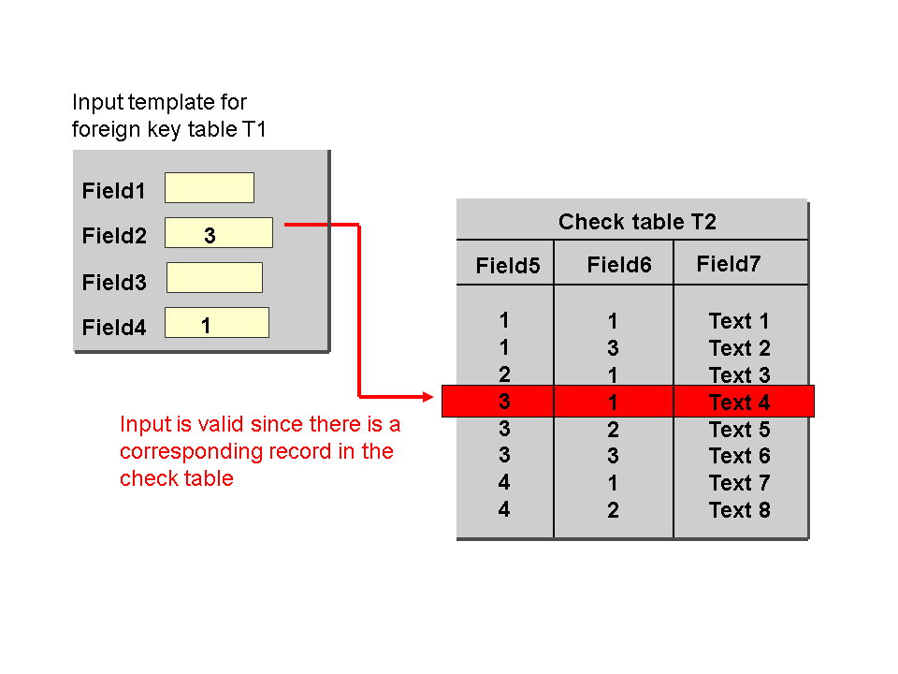
Overview
Establishing relationship between two tables to validate entries in one table against other table.
The pair of fields for the two tables must have the same data type and length.
A foreign key allows you to assign data records in the foreign key table and check table.
By using the entries in the foreign key fields, one record of the foreign key table uniquely identifies one record of the check table.
26

Slide 27
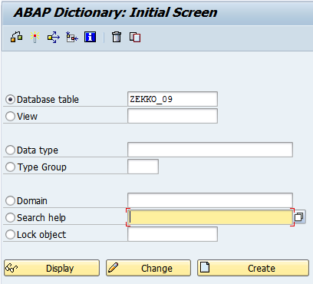
Create Database Table
Structure or definition of database table is created and with this structure of physical database table is created in the underlying database system.
1. Select Database table Radio Button
2. Enter Database table Name
3. Click on Create Button
27

Slide 28
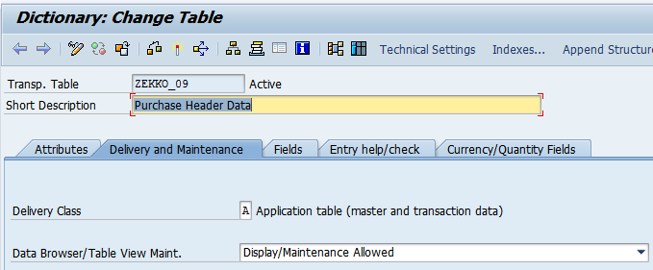
Create Database Table
Structure or definition of database table is created and with this structure of physical database table is created in the underlying database system.
5. Select Delivery and Maintenance Tab
4. Enter short Description
6. Specify Delivery Class
7. Choose Data browser/Table Maintenance
28

Slide 29
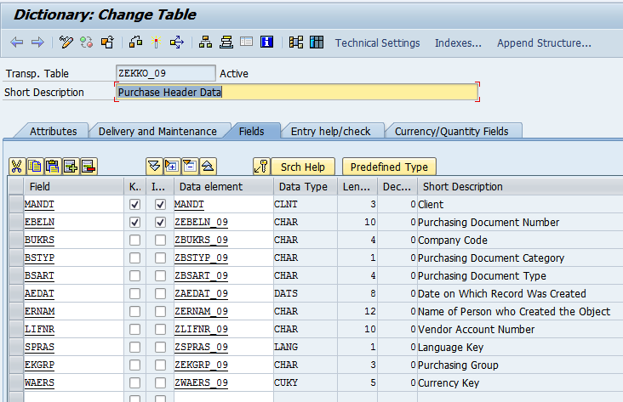
Create Database Table
Structure or definition of database table is created and with this structure of physical database table is created in the underlying database system.
8. Select Fields Tab
9. Enter Field Name
Select Key Field Check box if required
Select Initial Check if required
Specify Data Element
Repeat the steps from 9th to 12th Steps for each field
29

Slide 30
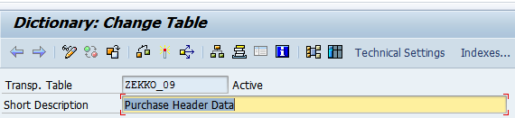
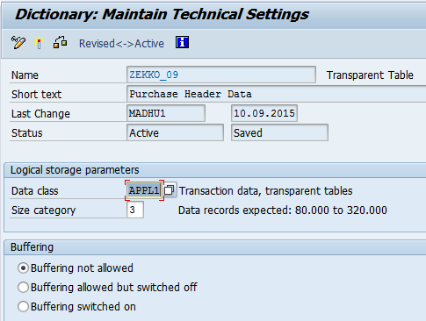
Create Database Table
Structure or definition of database table is created and with this structure of physical database table is created in the underlying database system.
14. Select Technical Setting Button
15. Specify Data Class
16. Specify size category
17. Specify Buffering option if required
18. Specify Buffering type if Buffering switched on
19. Save , Syntax Check and Activate
30

Slide 31
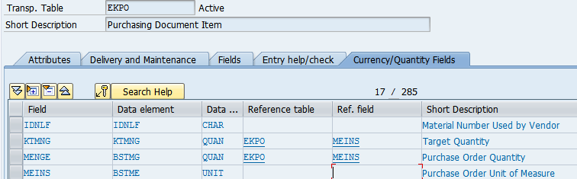
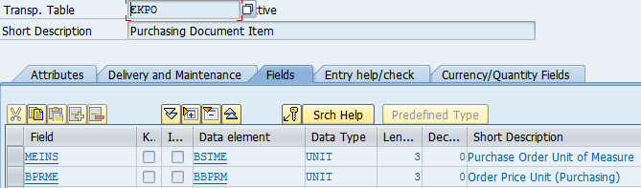
Create Database Table
Select Currencies/Quantity Fields
Structure or definition of database table is created and with this structure of physical database table is created in the underlying database system.
Fields KTMG and BSTME having data type of type QUAN
Reference field MEINS is assigned against above specified fields
BSTME field having data type UNIT
31

Slide 32
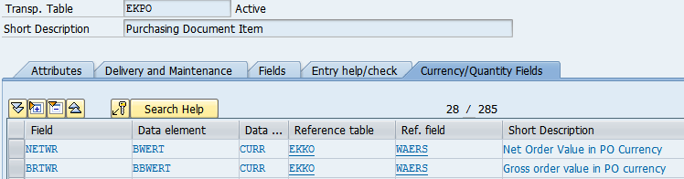
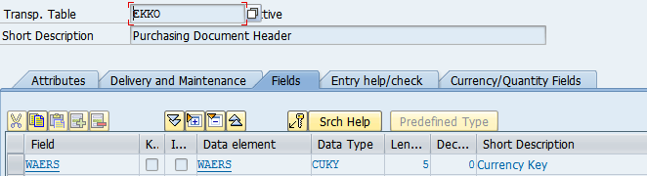
Create Database Table
Fields NETPR & BRTWR having data type of type CURR
Reference field MEINS is assigned against above specified fields
Structure or definition of database table is created and with this structure of physical database table is created in the underlying database system.
Select Currencies/Quantity Fields
WAERS field having data type CUKY
32

Slide 33
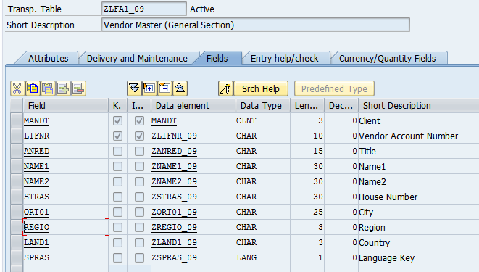
Create Database Table
We have table ZLFA1_09. LAND1 is country field. In SAP, List of Countries will be available in T005 Table. So we have to establish Foreign key between ZLFA1_09-LAND1 to T005-LAND1
33

Slide 34
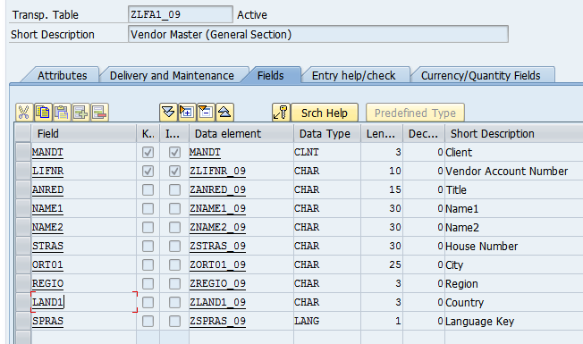
Create Database Table
2. Click on KEY button. Popup will be displayed
We have table ZLFA1_09. LAND1 is country field. In SAP, List of Countries will be available in T005 Table. So we have to establish Foreign key between ZLFA1_09-LAND1 to T005-LAND1
1. Place the cursor on the field
34

Slide 35
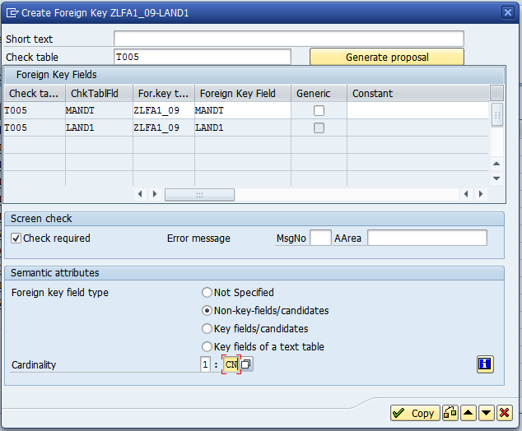
Create Database Table
We have table ZLFA1_09. LAND1 is country field. In SAP, List of Countries will be available in T005 Table. So we have to establish Foreign key between ZLFA1_09-LAND1 to T005-LAND1
4. If system not proposed any table then we have to enter the table here
5. Enter Foreign key field type and Cardinality
6. Click on Copy Button
35

Slide 36
Aggregate Objects
TMG
Views
Lock Objects
Search Helps

Slide 37
TMG Overview
It is generated program with one or two screens to allow the user to Insert/Modify/Delete values directly into the database table/Maintenance View.
Transaction to Maintain Entries: SM30
Create TMG for configuration tables which are having less number of fields
37

Slide 38
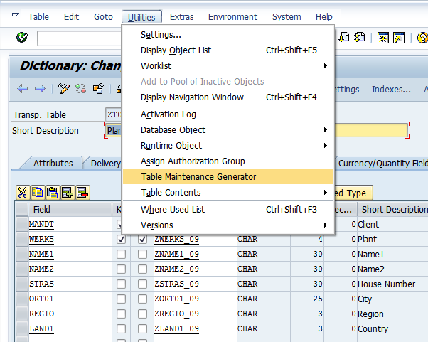
Create TMG
It is generated program with one or two screens to allow the user to Insert/Modify/Delete values directly into the database table/Maintenance View.
Transaction to Maintain Entries: SM30
Create TMG for configuration tables which are having less number of fields
Open Table in Change Mode
Click on Menu “Utilities”
Select Option “Table Maintenance Generator”
38

Slide 39
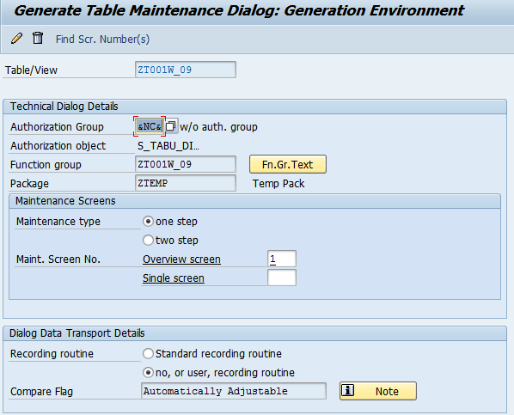
Create TMG
4. Enter Authorization Group
Ex: &NC& - No Authorization
5. Specify Function Group Name. It can be same as table Name
6. Specify Maintenance Type and enter Screen Number (
One screen mode or Two Screen Mode.
If you select One screen mode then you can enter multiple records at a time
If you select two screen mode then you can enter only one record at a time
7. Choose Recording routine. If we select Standard recording routine, then TR is mandatory
If we select No, or User recording routine then TR is not required
8. Then Click on Create button on application toolbar
39

Slide 40
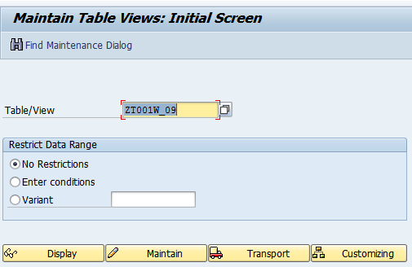
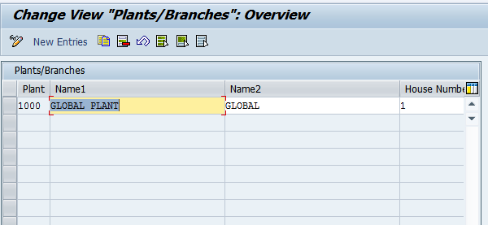
Maintain Entries via TMG
Go to SM30 Transaction
Enter Table Name
Click on Maintain Button
Click on New Entries Button
Enter Values and save
40

Slide 41
Views
Projection Views
Database Views
Maintenance Views

Slide 42
Views
Data about an application object can be distributed to several tables.
By defining a view, you can define an application-dependent view that combines this data.
The structure of such a view is defined by specifying the tables and fields used in the view.
Fields that are not required can be hidden, thereby minimizing interfaces
Types of Views
Projection View
Database View
Maintenance View
42

Slide 43
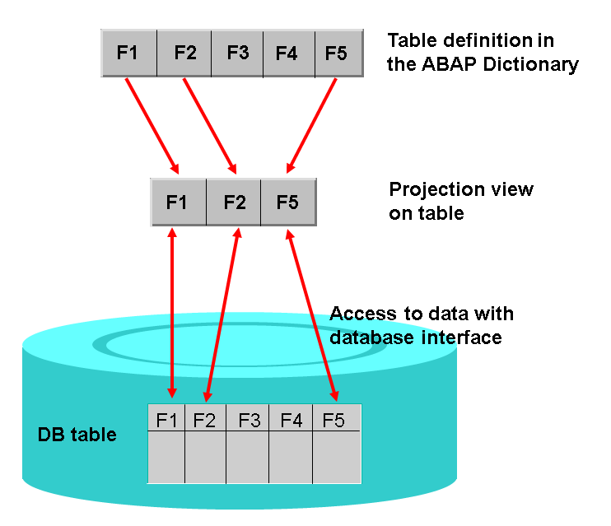
Project View
Projection views to hide fields of a table. This can minimize interfaces
A projection view contains exactly one table. You cannot define selection conditions for projection views.
43

Slide 44
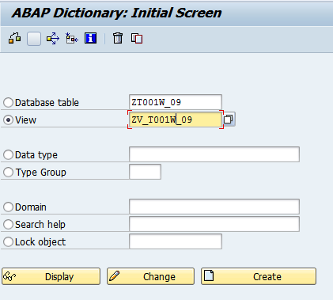
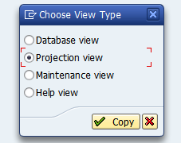
Create Project View
1. Select Radio Button View
2. Enter View Name
4. Select Project View Radio Button
3. Click on Create Button
44

Slide 45
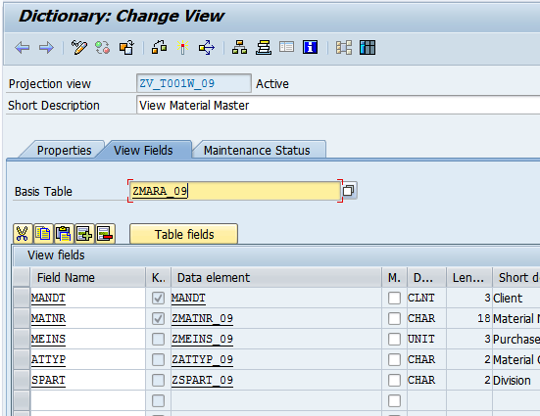
Create Project View
5. Enter Description
6. Select View Fields Tab
7. Enter Database Table Name
8. Enter required fields in the view
45

Slide 46
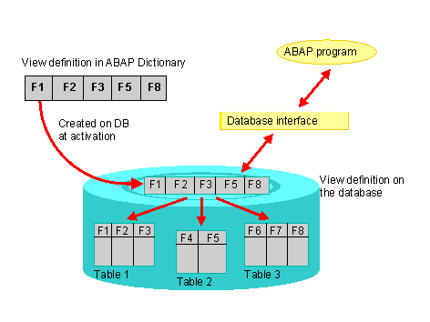
Database View
Data about an application object is often distributed on several database tables. A database view provides an application-specific view on such distributed data.
Database views are defined in the ABAP Dictionary. A database view is automatically created in the underlying database when it is activated
46

Slide 47
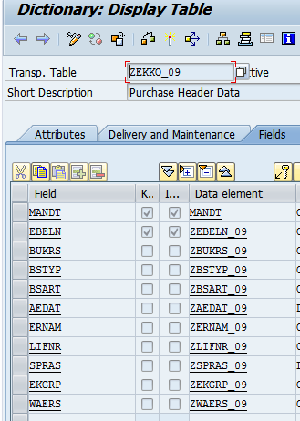
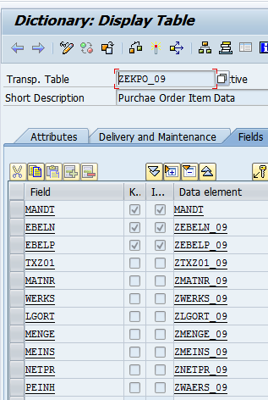
Database View
Example:
Let us assume application data distributed among tables ZEKKO_09 and ZEKO_09 and both are linked via Foreign key relationship. Now requirement is to combine data somehow.
47

Slide 48
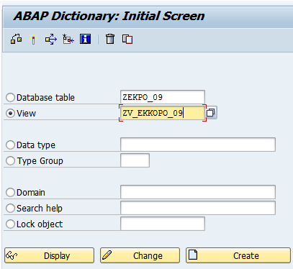
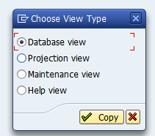
Create Database View
4. Click on Database View Radio Button and Copy
1. Select Radio Button View
2. Enter View Name
3. Click on Create Button
48

Slide 49
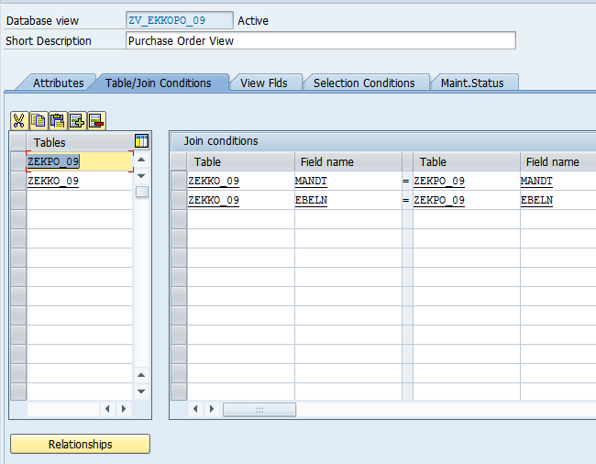
Create Database View
5. Enter short Description
6. Enter list of tables to be joined. In our case only two tables joined
7. Enter Join Condition. Join condition automatically come when we click on Relationships button in the below and selectin the relation ship
49

Slide 50
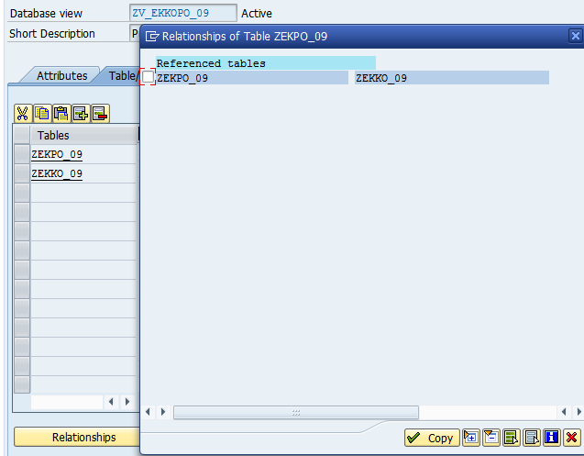
Create Database View
9. Select the entry
8. Click on relationship button
10 . Click on Copy button
50

Slide 51
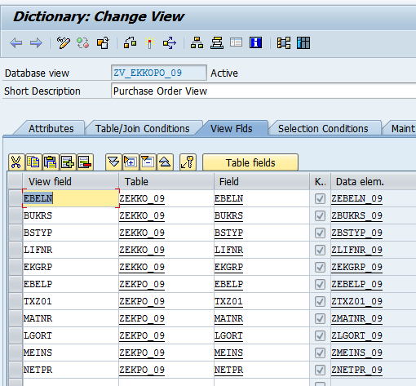
Create Database View
11. Select View Fields Tab
12. Select required fields from both the tables
13. Save
14. Activate
51

Slide 52
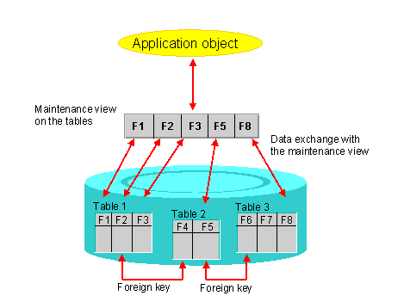
Maintenance View
A maintenance view permits you to maintain the data of an application object together.
Maintenance view is combination of View and Maintenance Generator. It involves Two steps
Create a View of type Maintenance View
Create TMG for Maintenance View
52

Slide 53
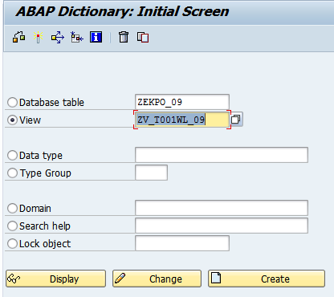
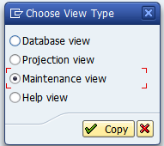
Maintenance View
1. Select Radio Button View
2. Enter View Name
3. Click on Create Button
4. Click on Maintenance View
53

Slide 54
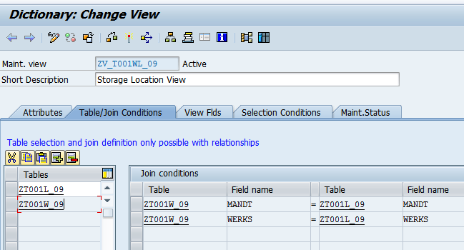
Maintenance View
5. Enter Description
6. Select Table/Join Conditions
7. Enter Tables to be joined. Enter Foreign key table first and then enter check table by selecting Relation ship button in bottom.
Join Condition automatically proposed
54

Slide 55
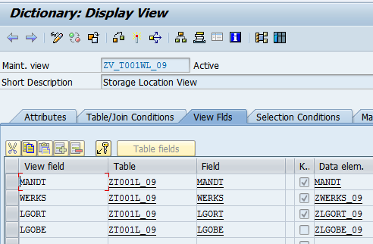
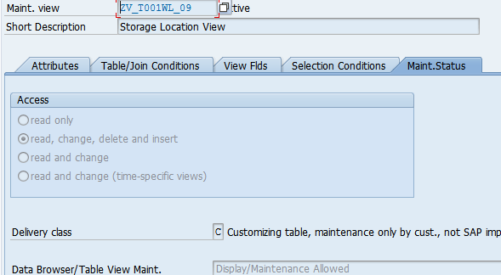
Maintenance View
8. Select View Fields Tab and select required fields from each table
9. Select Maint Status Tab
10. Maintain following
Access
Delivery Class
Data browser and Table View Maint
11. Save And Activate
55

Slide 56
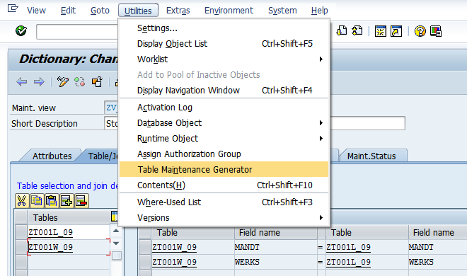
Maintenance View
12. Select Menu Option Utilities and then select option Table Maintenance Generator
56

Slide 57

Maintenance View
13. Specify Authorization Group
14. Specify Function Group
15. Specify Maintenance type as two step and enter two screen numbers
Then click on create button
Maintain entries in the view using transaction SM30
57

Slide 58
Search Help
Elementary
Collective

Slide 59

Search Help
Search helps are objects that you can use to assign input help (F4 Help) to screen fields.
You can do this by creating a search help in the ABAP Dictionary and attaching it to the corresponding screen field
59

Slide 60
Search Help
There are two types of search helps
Elementary search helps
Collective search helps: Collective search helps combine several elementary search helps. A collective search help can offer several alternative search paths.
Search help is the database object to provide value help functionality. It involves following steps
Create search help
Assign Search Help
We can assign at Data Element Level
We can assign at Table Field Level
60

Slide 61

Search Help: Example
Example:
when clicked F4 on Storage Location field in ME21N Transaction, Search help will be executed
61

Slide 62


Create Search Help
1. Select Radio Button Search Help
4. Click on Elementary Search Help
2. Enter name of Search Help
3. Click on Create Button
62

Slide 63

Create Search Help
5. Enter Description
6. Enter Table Name
7. Enter Fields
IMP – Importing
EXP – Exporting
LPos- List Position
Spos- Selection Position
M – Modifiction
You will get to know everything when testing the search hep
8. Save
9. Activate
63

Slide 64


Testing Search Help
Click on execute Button
Whenever clicked on execute button, one popup screen appeared. This is called selection screen. Here Fields are arranged in a order in the order of SPos specification. Click on Enter
64

Slide 65

Testing Search Help
This is called output list. Order of field in the output list is same as LPos
65

Slide 66

Assigning Search Help
Assign Search help to the Data Element
Data Element: ZLAND_09. Open Data Element in Change mode
1. Select Datatype Radio Button
2. Enter Data Element Name
3. Click on Change Button
66

Slide 67
Assigning Search Help
Assign Search help to the Data Element
Data Element: ZLAND_09. Open Data Element in Change mode
1. Select Datatype Radio Button
2. Enter Data Element Name
3. Click on Change Button
67

Slide 68

Collective Search Help
Collective Search Help
68

Slide 69

Collective Search Help
Collective Search Help
69

Slide 70
Lock Object

Slide 71
Lock Object
Synchronizes several users' simultaneous access to the same data records with a lock mechanism
Types of Locks
Shared Lock: User request for display - S
Exclusive Lock: User request for modify - E
Exclusive But not cumulative: allow the user to run single instance of transaction - X
Optimistic Lock: It is behaves as shared lock initially later it will be converted as Exclusive Lock - O
When you activate a lock object in the ABAP Dictionary, the system automatically creates function modules for
Setting (ENQUEUE_<lock object name>) and
releasing (DEQUEUE_<lock object name>) locks
71

Slide 72

Create Lock Object
Go to transaction SE11 and click on Lock Object Radio Button
Enter Lock Object Name
Click on Create Button
72

Slide 73

Lock Object
Enter Description
Select Table Tab
Select Table Tab
Select Lock Mode
73

Slide 74

Lock Object
System automatically propose all the key fields of the table as Lock parameters.
We add additional fields as lock Parameters or can remove existing proposed fields
Save and Activate
Select Lock Parameter Tab
Select Fields
74

Slide 75
Others
Text Tables
Database Utility

Slide 76


Text Table
Text Table:
Text table is a table to maintain language specific text to the entries of check table
Ex: MARA – Material Master Data
MAKT – Language specific text for Each Material
Rule:
Key fields of the Text table are
1. All Key fields of Check table and
2. Language field SPRAS
76

Slide 77
Database Utility
Database Utility is used to carry the changes in the table from Data Dictionary to Underlying Database.
When you make any changes to key fields in the table then it is necessary to run the database utility to adjust the tables in the underlying database tables.
Changes for the Key fields include
Making non key fields as key fields
Making key fields as non key fields
Changing data type of the key fields
77

Slide 78


Database Utility
Enter Table Name
Click on Edit Button
Processing Types
78

Slide 79
Database Utility
Create database Table: This button enabled only when table does not exists in the database
Delete database table: if you want to create a table at database then we go for this option
Activate and Adjust database: when table not activated properly from SE11 then we will choose this option to activate at database level
Save Data: when you made any changes to the table and if table contains entries then you have to go for this option to retain data in the table
Delete Data: when you don’t want any entry from the table then you can choose while adjusting table
79

Slide 80
Database Utility
80

